Slide 1

The Impact of Weather on Traffic Accidents in NYC
An Analysis of the Correlation between Weather Conditions and Traffic Accidents
Presenter: Ismail Halil Kuzu
Date: July 8, 2024

Slide 2

Introduction
Objective: Explore the relationship between weather conditions and traffic accidents in New York City
Key Question: How do different weather conditions affect the frequency and severity of traffic accidents in NYC?

Slide 3

Data Sources
Datasource 1: NYC Traffic Accidents
- Metadata URL: NYC Traffic Accidents - Metadata
- Data URL: NYC Traffic Accidents - Data
- Details: Information about traffic accidents recorded in NYC from January 2020 to August 2020
Datasource 2: NYC Weather Data
- Metadata URL: NYC Weather - Metadata
- Data URL: NYC Weather - Data
- Details: Weather parameters recorded in NYC during the same period

Slide 4

Data Integration and Preparation
Process: Filtering and merging the datasets based on the common date field
Goal: Facilitate analysis of the combined dataset to identify correlations between weather conditions and traffic accidents

Slide 5

Exploratory Data Analysis (EDA)
Monthly Traffic Accidents: Distribution of traffic accidents over months to identify seasonal patterns
Figure 1: Total Accidents by Month

Slide 6
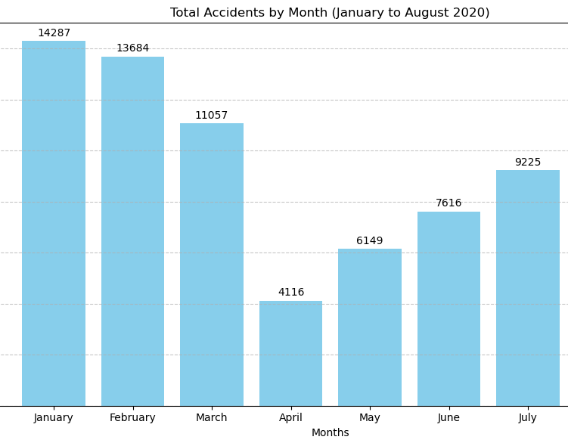
Figure 1: Total Accidents by Month

Slide 7

Weather Variables Analysis
Temperature and Accidents: Analyzing the variation of average temperature across different months
Figure 2a: Average Temperature and Total Accidents by Month
Precipitation and Accidents: Analyzing the variation of total precipitation across different months
Figure 2b: Total Precipitation and Total Accidents by Month

Slide 8
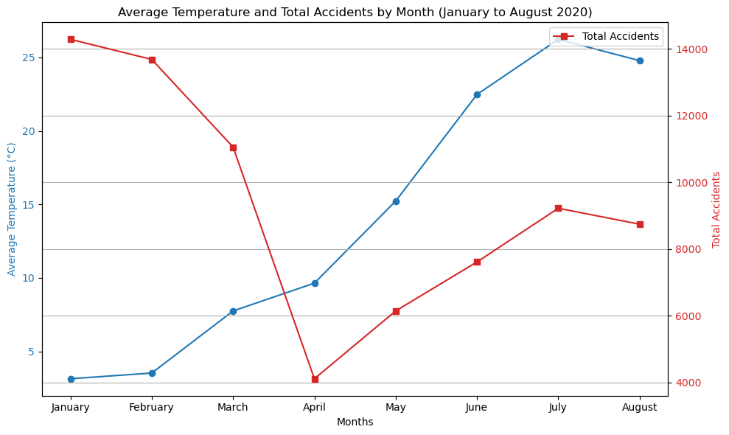
Figure 2a: Average Temperature and Total Accidents by Month

Slide 9
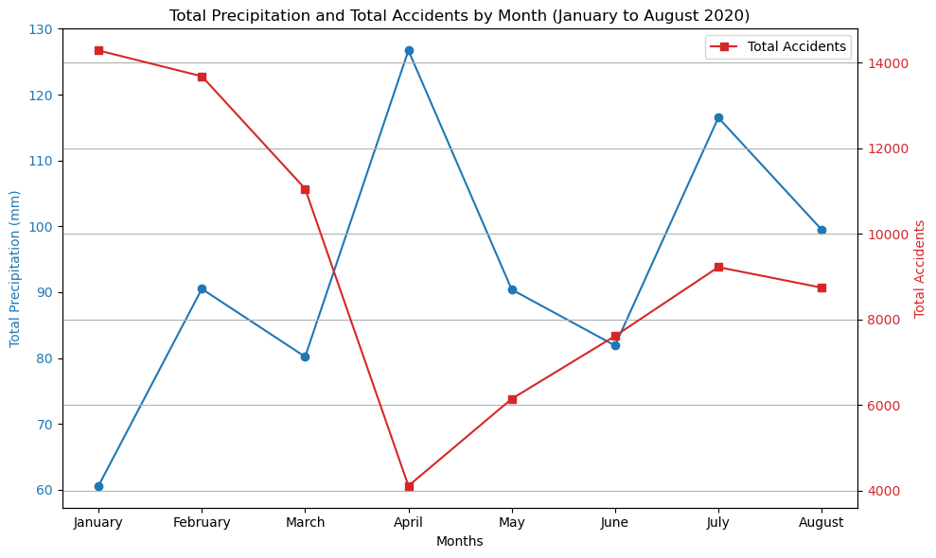
Figure 2b: Total Precipitation and Total Accidents by Month

Slide 10

Further Weather Analysis
Cloud Cover and Accidents: Analyzing the variation of average cloud cover across different months
Figure 3a: Average Cloud Cover and Accident Count by Month
Wind Speed and Accidents: Analyzing the variation of average wind speed across different months
Figure 3b: Average Wind Speed and Total Accidents by Month

Slide 11
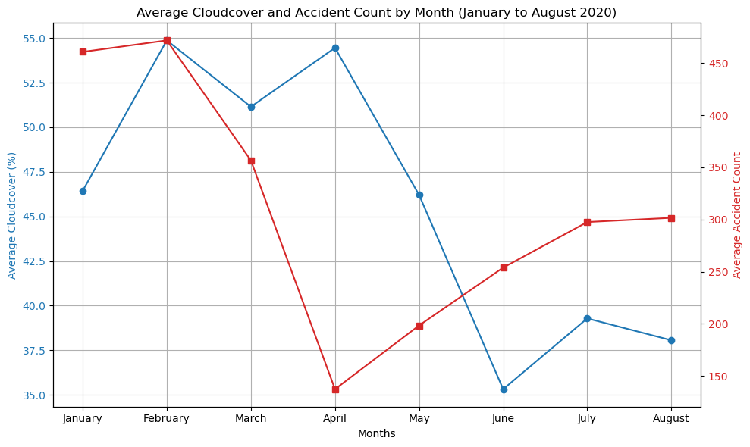
Figure 3a: Average Cloud Cover and Accident Count by Month

Slide 12
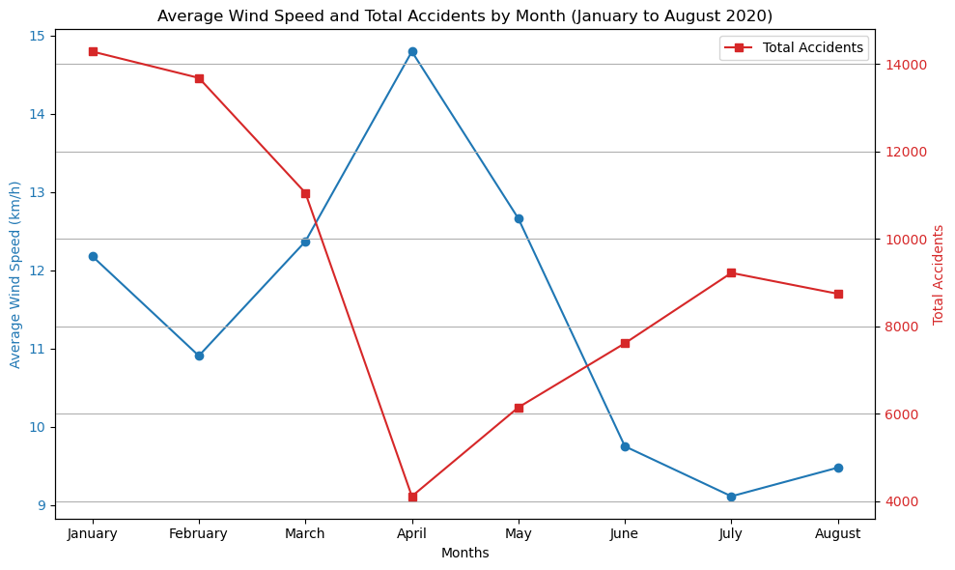
Figure 3b: Average Wind Speed and Total Accidents by Month

Slide 13
Correlation Analysis
Objective:
Identify correlations between weather variables (temperature, precipitation, cloud cover, wind speed) and traffic accidents
Techniques:
Statistical analysis and descriptive statistics to quantify effects

Slide 14
Key Findings
Temperature:
Higher temperatures correlate with an increase in traffic accidents. This may be due to higher pedestrian and vehicle activity during warmer weather
Precipitation:
Heavy precipitation leads to a higher rate of accidents, highlighting the dangers of wet road conditions
Cloud Cover:
Moderate levels of cloud cover showed mixed effects
Wind Speed:
Increased wind speed is associated with a slight rise in accidents, possibly due to reduced visibility and control for drivers

Slide 15

Limitations and Uncertainties
Focus: Correlational relationships, not causation
Scope: Limited to NYC and a specific time period (January 2020 to August 2020)
Generalizability: Findings may not apply to other regions or different years

Slide 16
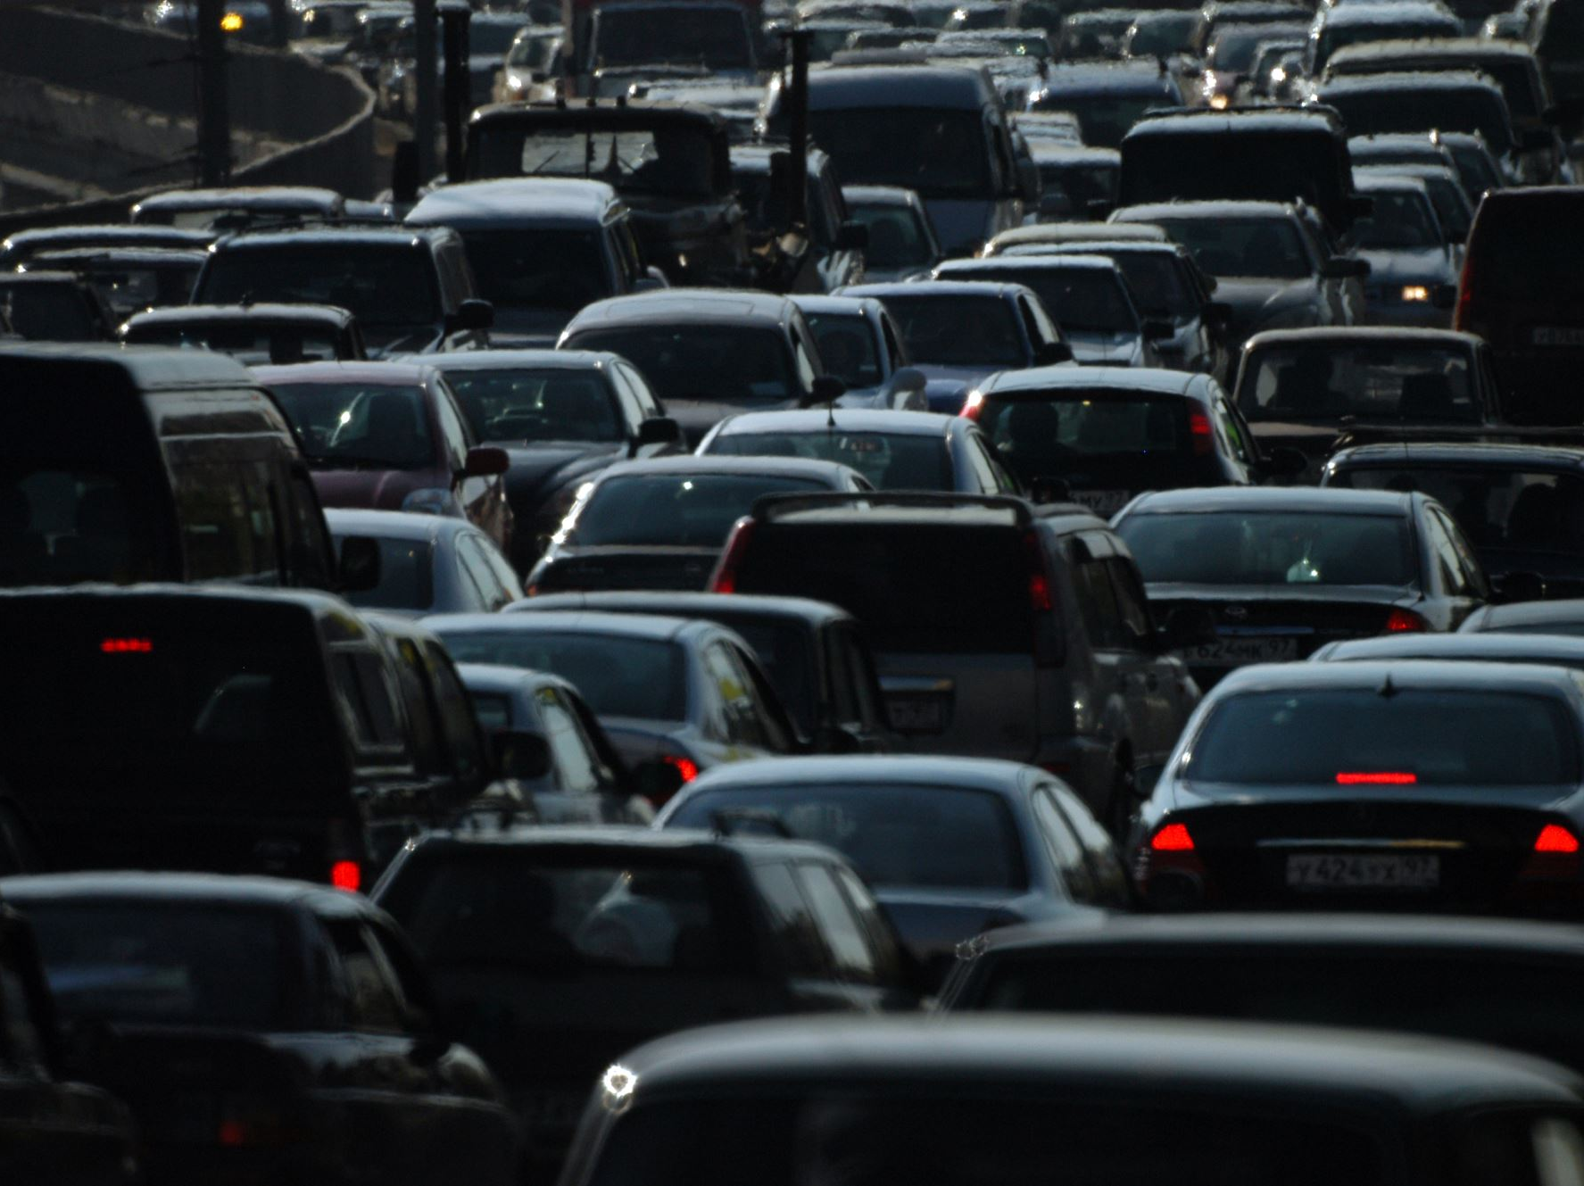
Conclusions
Impact: Weather conditions influence traffic accident rates in NYC
Future Research: Larger datasets and extended time periods needed for deeper insights
Policy Implications: Informing safety measures and traffic management strategies

